Slide 1



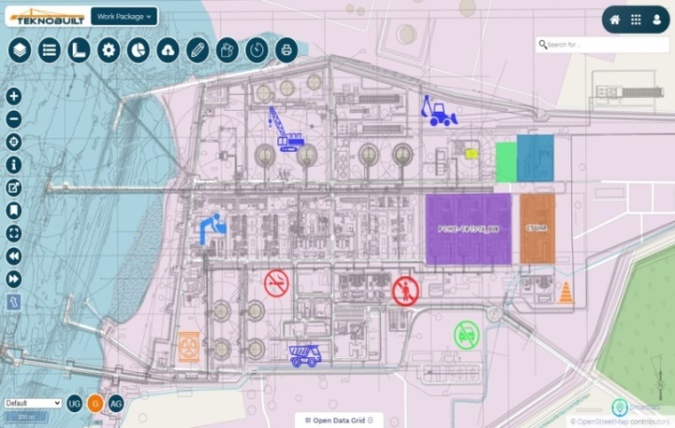







Helping the World Build Better Digitally
PACE HSE
End to End Digital HSE Platform
with AI & GIS Technology

Slide 2
Agenda
Requirement for Broadcast & Media Channel

Slide 3
Purpose
To Show the HSE Related content in Various TV Screens in NTPC Project in the form of a Media Channel (PACE TV)

Slide 4

Broadcast and Media Channel
1
Weather Dash board
2
3
This will show efficiencies and HSE content
4
UI Need to change As per NTPC
Weather, Stock News & News Feed should be Dynamic

Slide 5
Screen contents
Box | Content to be Shown | Type of content
Box 1 | Content Posted through the Make Broadcast Request If admin User want to project any Content | PDF, PPT, Videos (Values Safety Stars / Recognitions & Rewards, Critical Works ongoing, Notifications, Safety Slogans)
Box 2 | Weather Dashboard for Project Location | Weather details
Box 3 | News headlines and also content can added by Admin for Box 3 Like HSE Stats and figures | Initially stock news will shown Below stock news if any content will be added by admin will appear.
Box 4 | News Feed Content added by Admin for Box 4 Like NTPC Values, Messages, Stars, Notifications etc | Text which will be added by admin

Slide 6
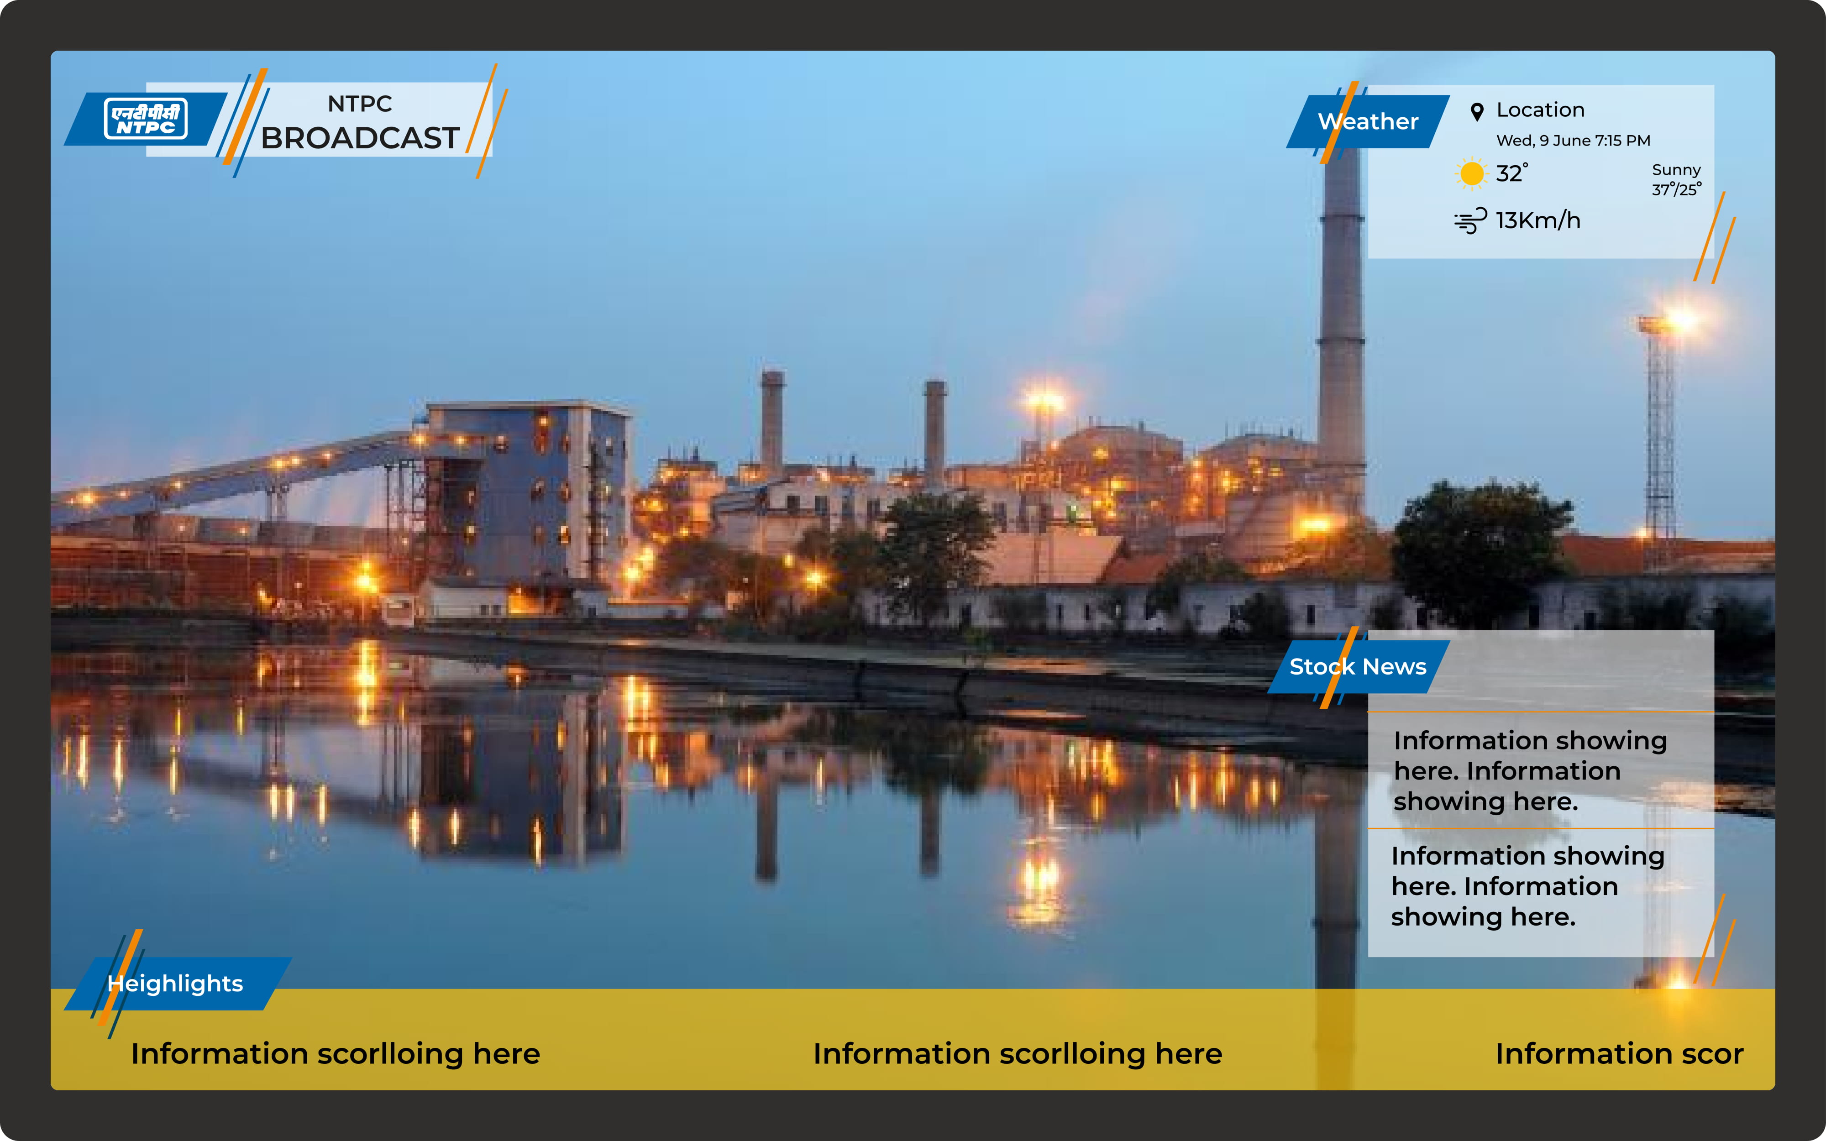

Slide 7


Weather Dashboard
Date: 03-06-2021
Time: 02:47 PM
Temperature: 36/30˚
Wind: 13Km/h
Weather: Light rain. Increasing cloudiness.
* Precautions Need to scroll
Weather Dashboard Example
https://www.timeanddate.com/weather/india/guntur/ext

Slide 8
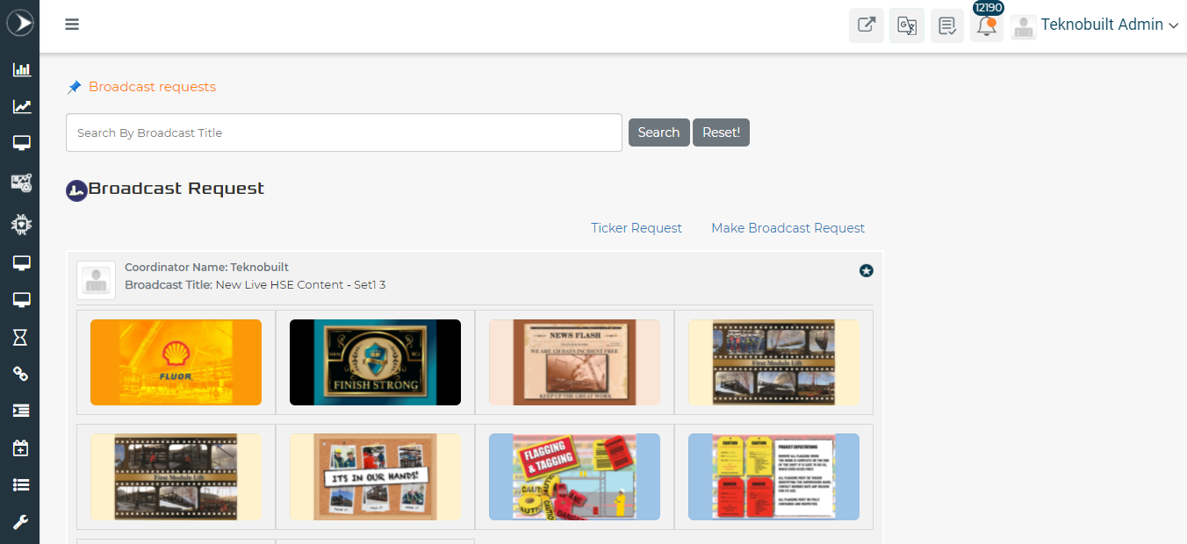
Creating Broadcast Request
To create a New Broadcast Request
Screen 1
Screen 3
Screen 4

Slide 9
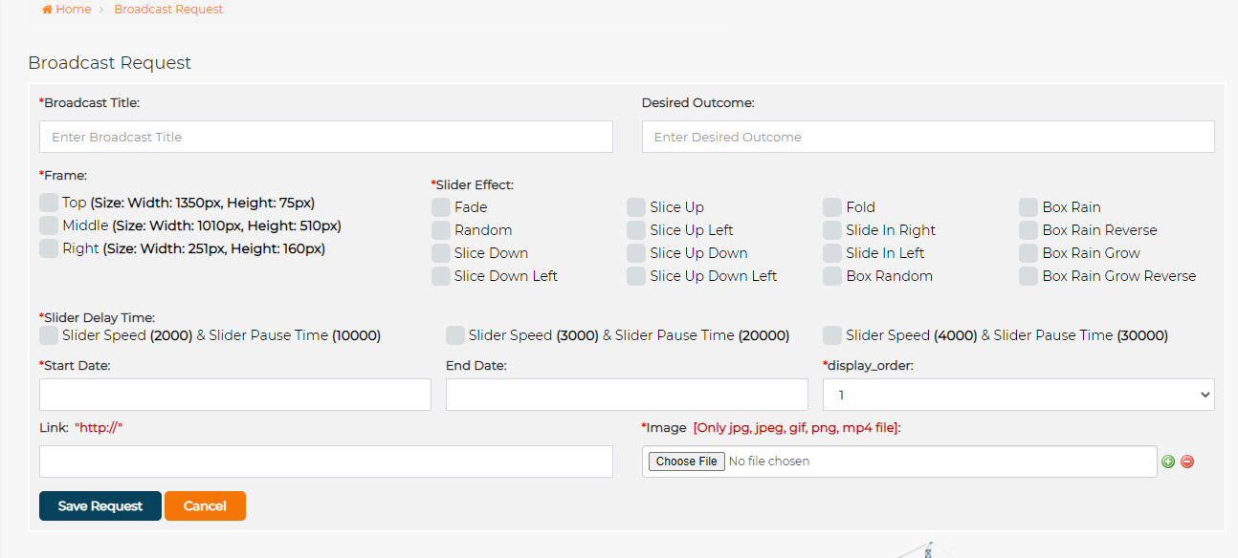
Creating Broadcast Request

Slide 10
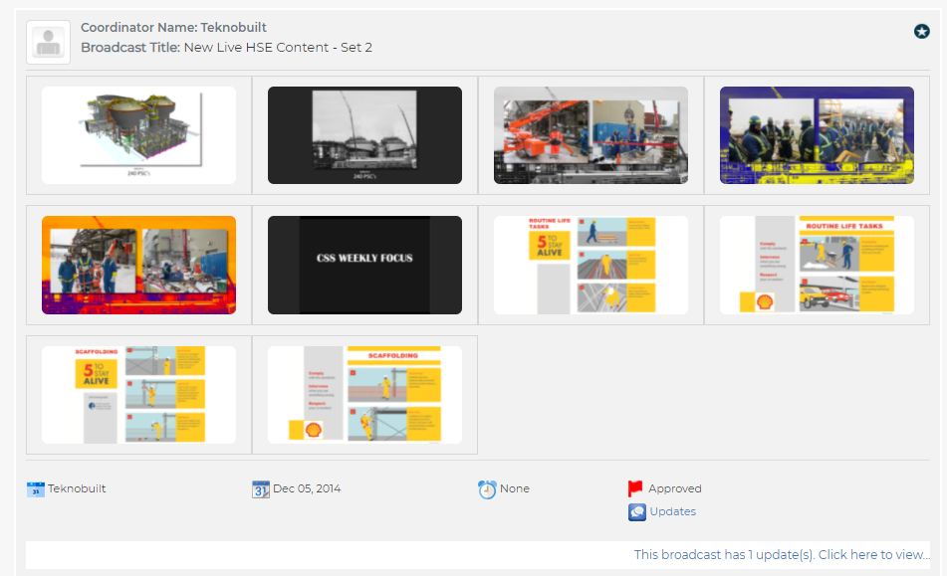

Broadcast Request
Delete option need to be Provided
When User clicks Favorite then a Separate Dashboard will appear for favorite packages

Slide 11
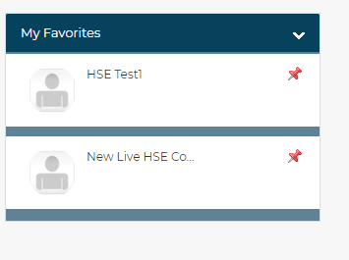
Favorite/ Play Dashboard
Available Screens
Screen 1
Screen 2
Screen 3
Enable
Disable
Project
Select Content
1
Content 1
Content 2
Content 3
Content 4
2
Should have option for selecting the Preference to play

Slide 12
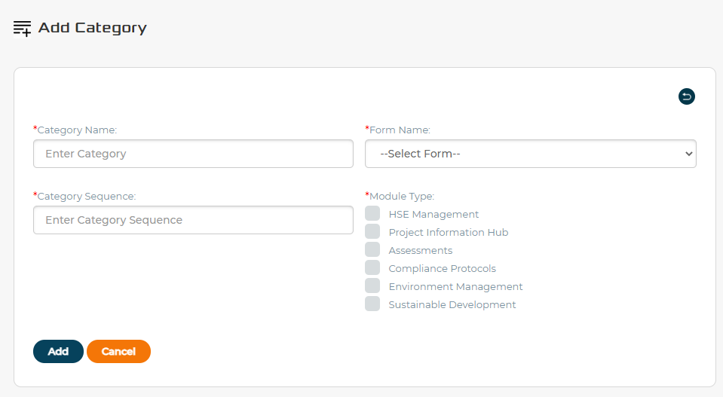
Screen 3
Content
Content
Value
Slide
Number of Accident free days
314
User adds content to be Displayed
User adds Values if any
Selects the batch/ Set

Slide 13
Screen 4
Content
Content
Value
Training is on control Room at 7.30
User adds content to be Displayed
User adds Values if any

Slide 14



Enter the Future of
Digital HSE
305, Fulham Palace Rd., London, SW6 6TL, United Kingdom
+44-7977-171-171
1111, 10th Street SW Calgary, AB T2R 1E3, Canada
+1-844-835-6610
Canada | UK | USA | India | S. Korea | Italy | MENA

